Slide 1
Ch. 21-22 Exploding Stars & Black Holes

Slide 2
I. NOVA
Mass-transfer binary incl. w.dwarf
Accretion disk forms (X-rays, UV)
Surface fusion
Becomes a million x brighter
2 or 3 seen per yr.
Recurring nova

Slide 4
II. Type I Supernova
A. Recurring nova increases
white dwarf’s mass up to..
B. ..the Chandrasekhar limit:
max. mass of a w. dwarf: 1.4 M_{sun}
C. Carbon fusion begins simultaneously throughout core
D.White dwarf explodes (no H₂ in spectra)

Slide 5
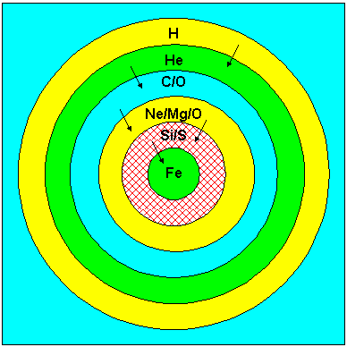
III. Heavy Element Fusion in Massive Stars
A. Elements up to iron fuse
B. Time decreases
for each stage:
O₂ 1 yr.
Si 1 wk.
Fe 1 day

Slide 7
C. Iron is the most stable element
1. No natural fission or fusion
2. Photodisintegration of core
3. Quickly collapses
D. e’s & protons fuse into neutrons
E. Neutron degeneracy prevents total collapse
F. Collapse rebounds in < 1 sec.

Slide 8
IV. Type II Supernova
A. Core-collapse of massive star
B. Rebounding shock wave blows
outer layers of star into space
C. As bright as an entire galaxy!
D. Signature:
1. Abundance of H₂
2. Plateau in light curve

Slide 12
Supernova 1987A
- 20 yrs. later

Slide 13
Eta Carinae

Slide 15
SN2006GY (most powerful ever recorded at the time)

Slide 16
“Red Square”, 2007

Slide 17
V. Comparisons
A. Supernova vs. nova
1. Light curves have same shape
2. Supernovae have much greater energy and are a million x brighter than a nova
B. Type I Supernova vs. Type II
1. Different mechanisms, roughly equal energy
2. Type II are more common, but not by much
a. Almost all high-mass stars -Type II
b. Few low-mass stars go Type I
c. Many more low-mass stars, though
3. Type I more consistent (standard candles)

Slide 18
VI. Supernova Remnants
A. Nebulae leftover from explosion
Ex/ Crab Nebula (M1)
1. Daytime explosion 1054 A.D.
2. Doppler- rapid expansion today
B. No supernova in Milky Way since Kepler’s in 1604. We’re overdue!
C. Supernova 1987A: Most studied
D. Over 200 SNR’s in our Galaxy

Slide 19
The Crab Nebula

Slide 20
Veil Nebula

Slide 21
VII. Formation of the Heaviest Elements
81 stable + 10 radioactive on E
Regular fusion, helium capture occur up to iron
Neutron capture for Cu, Au, Ag..
Heaviest elements form within first 15 minutes of supernova!
Stars formed recently - more heavy elements

Slide 22
Ch. 22 Neutron Stars & Black Holes

Slide 23
I. Neutron Stars
A. Dense core of neutrons left after
Type II supernova (not Type I)
B. Misnomer - No fusion
C. Extremely small & dense
1. Size of Manhattan (> M_{sun})
2. Weight of 1 thimble = mountain!
3. Solid surface (you - paper thin..)

Slide 24
D. Neutron stars rotate rapidly
1. Many times per second Why?
2. Conserv. of Angular Momentum: Radius decreases, spin accelerates
Ex/ Figure skater
E. Very strong magnetic fields
1. Field lines squeezed close
2. 1 trillion x stronger than E’s

Slide 25
II. Pulsars
Spinning neutron stars may emit
bursts of radiation that we may detect
B. Observed by Jocelyn Bell (1967)
C. Uniform pulses - accurate clocks
D. Lighthouse model (Anthony Hewish)
E. Not all neutron stars are pulsars
1. Some stop spinning
2. Beam may miss Earth

Slide 26
F. Other properties
1. Many pulsars found within supernovae remnants
Ex/ Crab (33 pulses / sec)
2. Most pulses are radio (LGM’s)
3. Millisecond pulsars (??) -
incoming matter accelerates old
neutron stars? X-ray bursters??

Slide 27
III. Gamma Ray Bursts
Very energetic bursts
Compton detected ~1 per day
Distributed evenly across sky
Never repeated
Colliding binary neutron stars?
Accretion disk of new black hole?
(Hypernova) - Swift (2004)

Slide 28
Most distant GRB ever detected

Slide 30
Computer Simulation of Neutron Stars Colliding
http://www.nasa.gov/multimedia/videogallery/index.html?media_id=78319231

Slide 31
IV. Black Holes
A. Collapsed massive star (~ 25 M_{s})
B. Neutron star > ~3 M_{s} will implode
C. Curved Space
Relativity explained gravity (1916)
All matter warps space *waterbed
Greater mass, greater curvature
Both matter and light follow the path of curved space

Slide 33
D. Escape velocity: Speed needed to escape gravity
1. Earth: 11 km/s
2. Grape-size Earth: 300,000 km/s
3. Any massive object can become a black hole

Slide 36
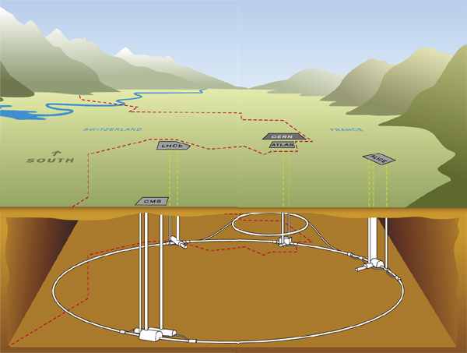
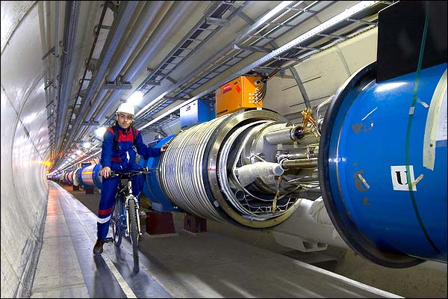

Slide 37
E. Event horizon
1. Distance from a black hole at
which escape velocity = c
(aka Schwarschild radius)
a. 3 km x the object’s solar mass
b. Jupiter - 3m; You - proton!
2. Core shrinks- “singularity point”

Slide 38
The Singularity

Slide 39
Worm Holes?

Slide 40
F. Effects of a black hole
1. Outside the event horizon, a black hole’s gravity is no different than a star’s gravity
2. Objects stretched out - __________
3.Torn matter creates heat in the form of X-rays
4. Time dilation for observer
5. Gravitational redshift: Radiation does work to escape - lower freq.

Slide 43
G. Evidence
1. Binary system with a massive,
invisible companion
2. Cygnus X-1: 10 M_{s}, X-rays..
First confirmed stellar black hole
3. Supermassive black holes
a. Up to a billion solar masses!
b. Found at the heart of large galaxies Ex/ Milky Way (3 mill. M_{sun})
c. Jets of matter/energy leave vicinity

