Slide 1
Chap. 2b Celestial Mechanics
by Mr. Kyle Jeter

Slide 2
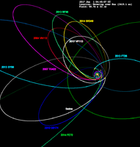
Kepler’s Laws of Planetary Motion
A. 1st Law – the Law of Ellipses
1. Planets orbit the Sun with
elliptical orbits, as do
comets, asteroids, etc…
2. The eccentricity of an orbit
is a measure of how egg
-shaped it is.
a. e = 0 indicates a circle.
b. All planets have an orbit
with e > 0

Slide 3
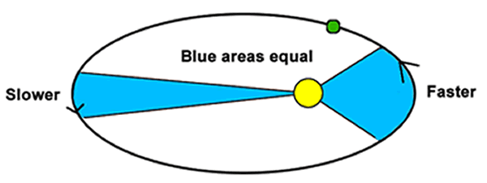
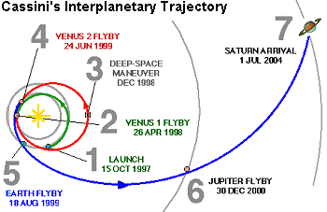
B. 2nd Law – the Law of Equal Areas
1. Planets carve out “equal areas” of
an orbit in an equal amount of time.
2. Therefore, planets must speed up close to the Sun!
3. NASA calls this the slingshot effect and has used it on
numerous missions including
Cassini and New Horizons.

Slide 4
C. 3rd Law –Law of Harmony
1. The square of a planet’s period is proportional to the cube of its *radius.
2. The period is measured
in YEARS.
3. The distance is
measured in AUs.
(astronomical units)

Slide 5
Example Problems
1. Neptune is 30.6 AU from the Sun. How many Earth
years does it take Neptune to orbit the Sun?

Slide 6
Example Problems
2. Mars orbits the Sun in 1.87 Earth years. How far is
Mars from the Sun?

Slide 7
Example Problems
3. Venus orbits the Sun in 223 days. How far is Venus
from the Sun?

Slide 8
II. Newton’s Laws of Motion
A. 1st Law – the Law of Inertia
1. An object at rest will stay at rest until acted on by an
overall force.
Ex/ Penny in the cup; tablecloth demo
2. An object in motion will continue in motion in a
straight line at constant speed until acted on by an
overall force (a push or a pull).
Ex/ Voyager I and II spacecraft
New Horizons

Slide 9
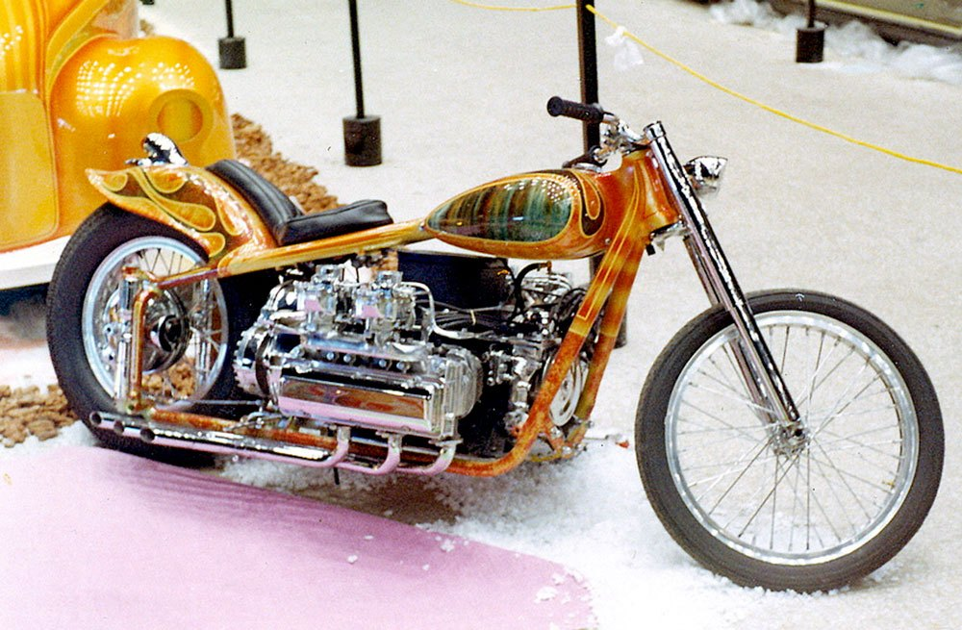
B. 2nd Law – the Law of
Acceleration
F_{NET} = ma
1. For the same amount of
Mass, applying a greater
Force will result in a greater
Acceleration.
Ex/ 750 cc engine vs. 1100 cc.

Slide 10
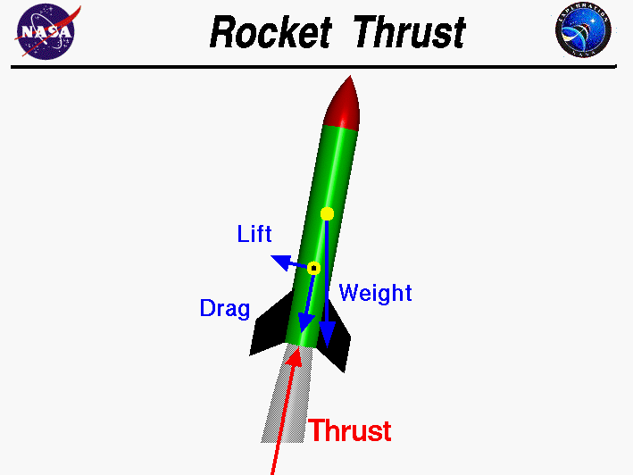
2. For the same amount of
Force, a greater Mass will
result in less Acceleration.
Ex/ Attaching a trailer to a truck.
Pushing a full grocery cart
vs. an empty one.
Rockets accelerating faster
after lift-off.

Slide 11
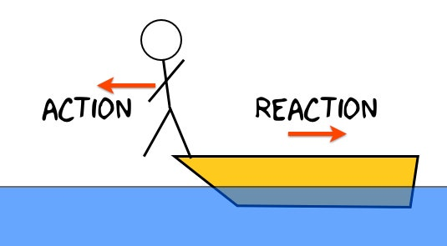
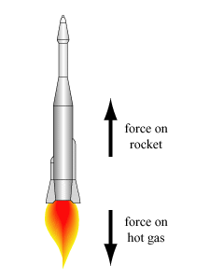
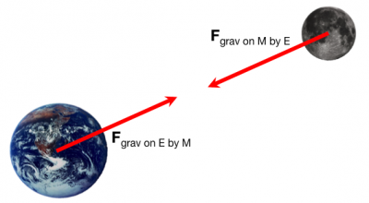
C. 3rd Law – ACTION / REACTION
For every Force, there is an
Equal and Opposite Force!
Ex/ Walking; swimming;
any vehicle; rockets,
the Earth-Moon system

Slide 12
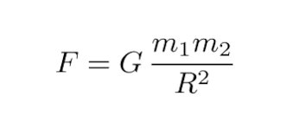
III. Newton’s Law of Gravitation
A. The amount of gravity
between ANY two objects
depends only on their MASS
and the DISTANCE between
them (*the distance between
the CENTERS of the objects)

Slide 13
B. The Universal Gravitational
Constant, G, is the same
everywhere in the
Universe. It is an
extremely small number,
indicating that gravity is
a very WEAK force!

Slide 14
Example Problems
4. If the Earth was the same size as now, but had 5 x its current mass, how would
its surface gravity compare to now?
5. If the Earth had its same mass as now, but had 3 x its current radius, how would
its surface gravity compare to now?
6. If you fly your spaceship 6 x farther from the center of a planet, by how much
would the force of gravity on you ship change?

Slide 15
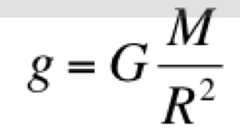
IV. Acceleration Due to Gravity
A. Newton’s Law of Gravity leads us to an equation for
the rate at which objects accelerate as they fall.
B. “Little g” for the Earth is 9.8 m/s². This means that an
object’s speed will increase by about 20 mph for every
second that it falls. (***without air resistance)

Slide 16
Example Problems
7. Calculate the acceleration due to gravity on the surface of the Moon.
Mm = 7.3 x 10²² kg
Rm = 1700 km
G = 6.67 x 10⁻¹¹

Slide 17
8. Calculate the acceleration due to gravity 2,000 km
above the surface of the Moon.

Slide 18
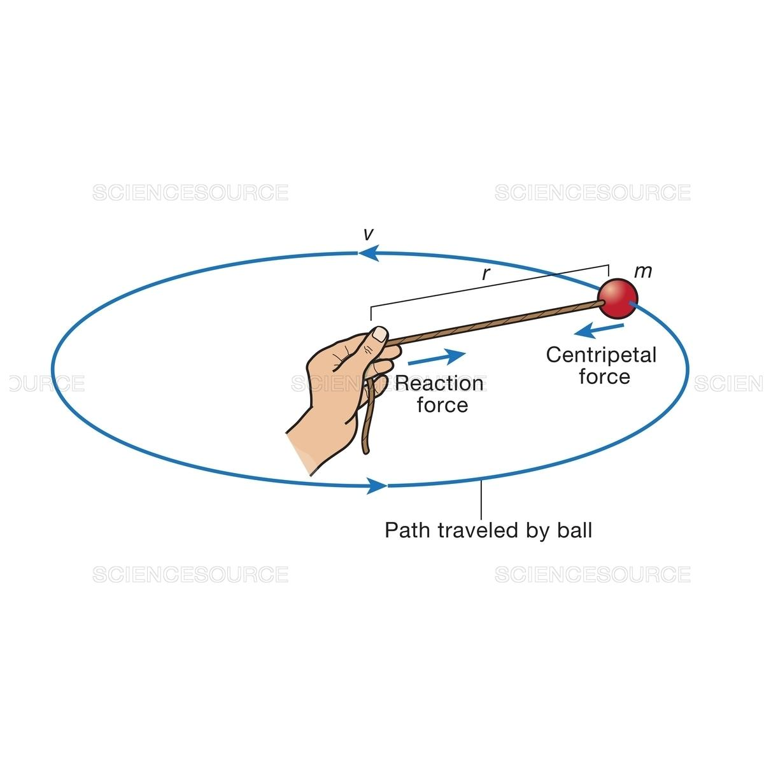
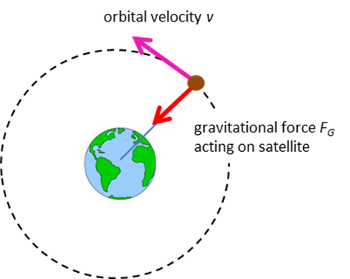
V. Center of Mass
A. Gravity acts as a centripetal
force (toward the center).
Ex/ A rock swung in a circle
on a string.

Slide 19
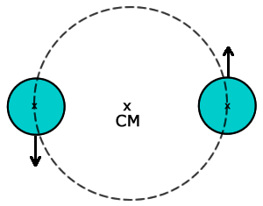
B. Celestial bodies actually orbit a common
center of mass.
1. If 2 objects are of EQUAL MASS, then their center of
mass will be exactly halfway between them. They will
both orbit that point in the center of that system.
Ex/ Binary stars

Slide 20
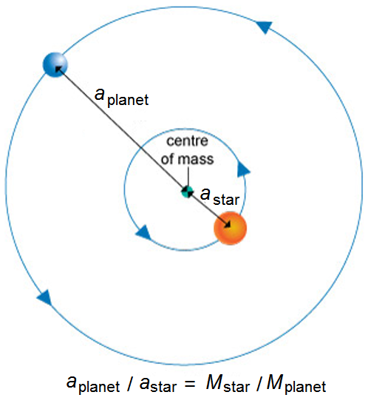
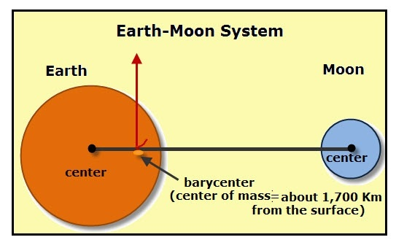
2. If the objects are of slightly different masses, the center
of mass will be closer to the heavier object.
Ex/ Pluto-Charon System
3. If the object have very different
masses, the center of mass of
the system may fall the heavier
object. Ex/ Earth-Moon

Slide 21
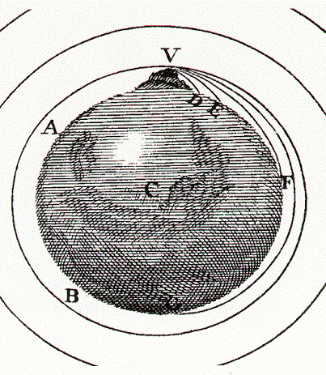
VI. Orbit and Escape Velocity
A. In Newton’s book The
Principia, he amazingly
showed how fast objects
would need to be launched
to both orbit the Earth and
to escape Earth all-together.
In other words, Newton
figured out the physics of
satellites in 1685 (!!).

Slide 22
B. Newton derived an equation to calculate the
velocity needed to orbit any celestial object.
(Orbital Velocity)
C. For the Earth, the orbital velocity is ~ 17,500 mph. This number is only for objects in a nearby orbit – L.E.O., or Low Earth Orbit. Ex/ I.S.S.

Slide 23
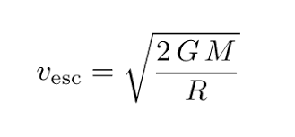
D. Newton then derived an equation to calculate the
speed needed to escape any celestial object.
(Escape velocity). For the Earth, v_{esc} ~ 25,000 mph!
*Note that the mass of the orbiting object doesn’t
matter! Also, ‘R’ is, again, the distance between
the centers of the objects.

Slide 24
Example Problems
9. What is the orbital velocity of the Moon?
M_{m} = 7.3 x 10²² kg
r_{m} = 1,700 km
G = 6.67 x 10⁻¹¹

Slide 25
10. What is the escape velocity of Ceres?
M_{c} = 9.0 x 10²⁰ kg
r_{c} = 470 km
G = 6.67 x 10⁻¹¹

Slide 26
11. What is the orbital velocity of the Earth at an
altitude 5,000 km above its surface?
M_{E} = 5.96 x 10²⁴ kg
r_{E} = 6.37 x 10⁶ m
G = 6.67 x 10⁻¹¹

Slide 27
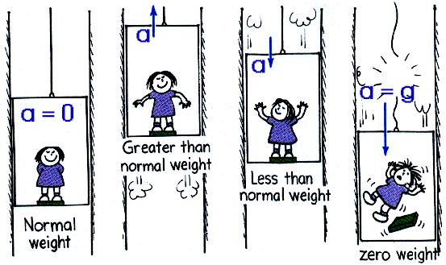
VI. Microgravity
A. Microgravity is
weightlessness due to
free fall. When an
object is falling it
weighs nothing!

Slide 28
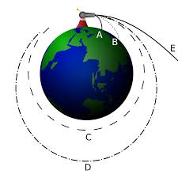
B. A satellite is actually
falling around the Earth!
Ex/ High dive;
Tower of Terror
G-Force One Airplane!
The I.S.S.

Slide 29
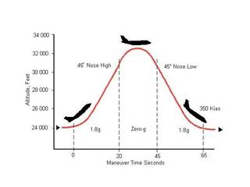
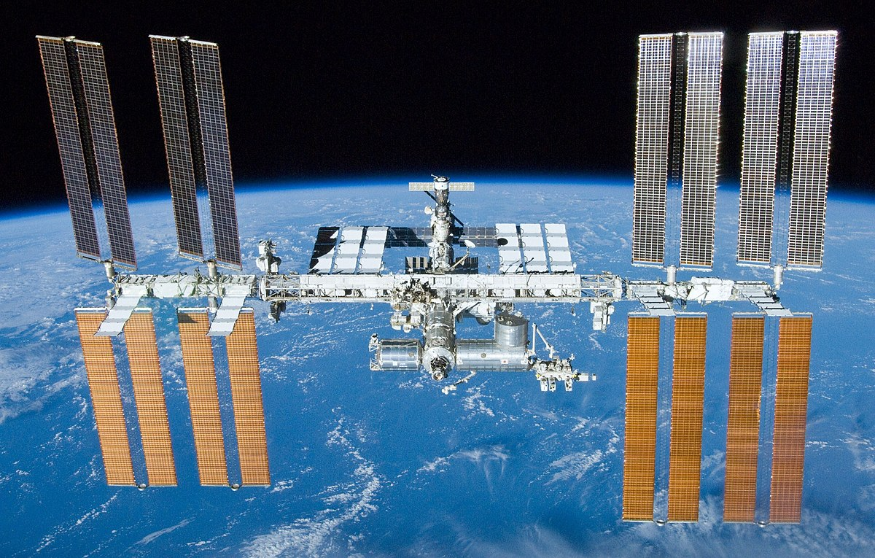

Slide 30
C. The Effects of Microgravity
1. Candle flames are spherical!
2. Water droplets are… spherical!
3. The effects on humans are numerous. Muscles get atrophied. May negatively affect eyesight.

Slide 31
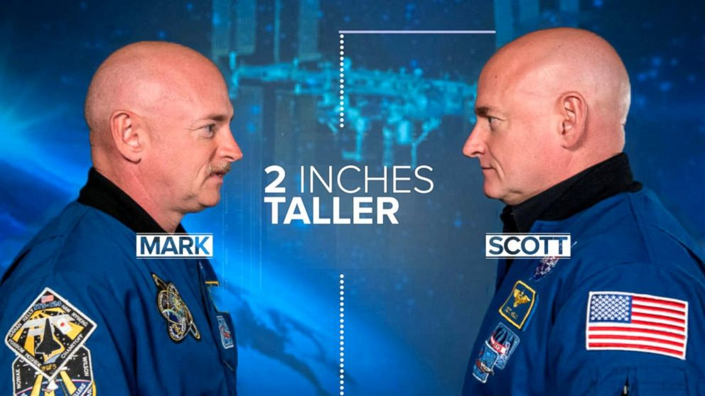
Fun fact:
Astronaut Scott Kelly became 2 inches taller than his twin, Mark Kelly, after spending a year in space!

Slide 32
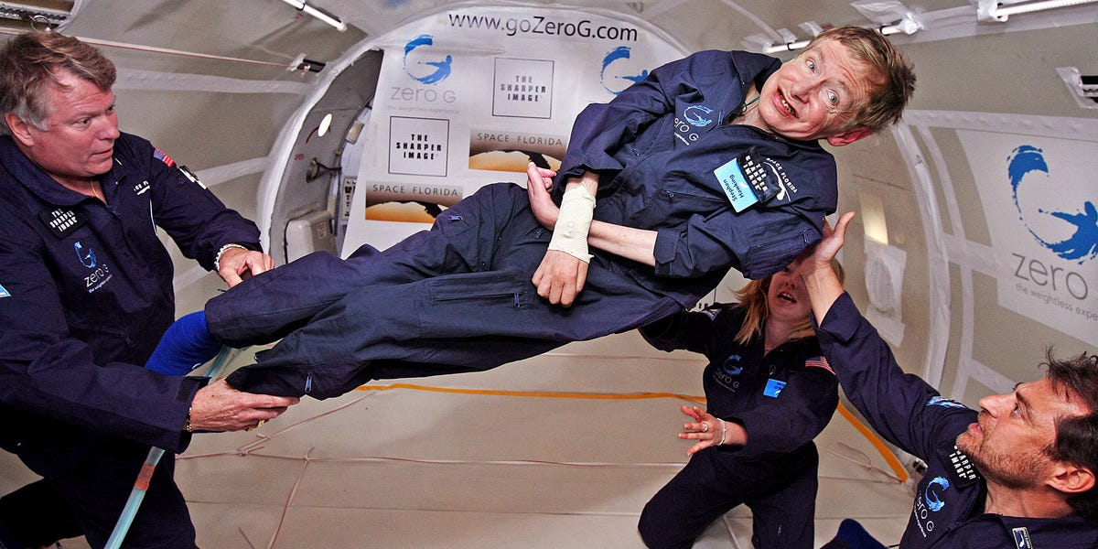
Fun fact:
Physicist Stephen Hawking got to experience weightlessness on the
G-Force One aircraft!

Slide 33
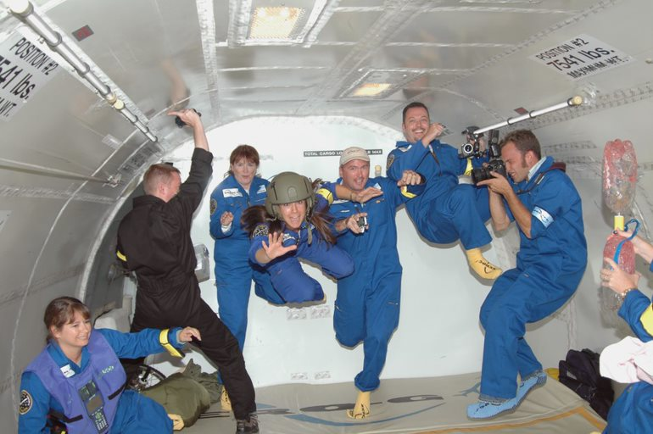
Fun fact:
In 2005, 15 teachers from Florida became the first educators to fly aboard the G-Force One aircraft…
…including a certain MSDHS Astronomy teacher…

