Slide 1
Ch. 6 The Outer Planets Sec 6.1 Jupiter

Slide 2
Jupiter as viewed by an Amateur Australian Astronomer

Slide 3
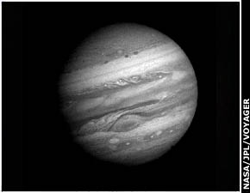
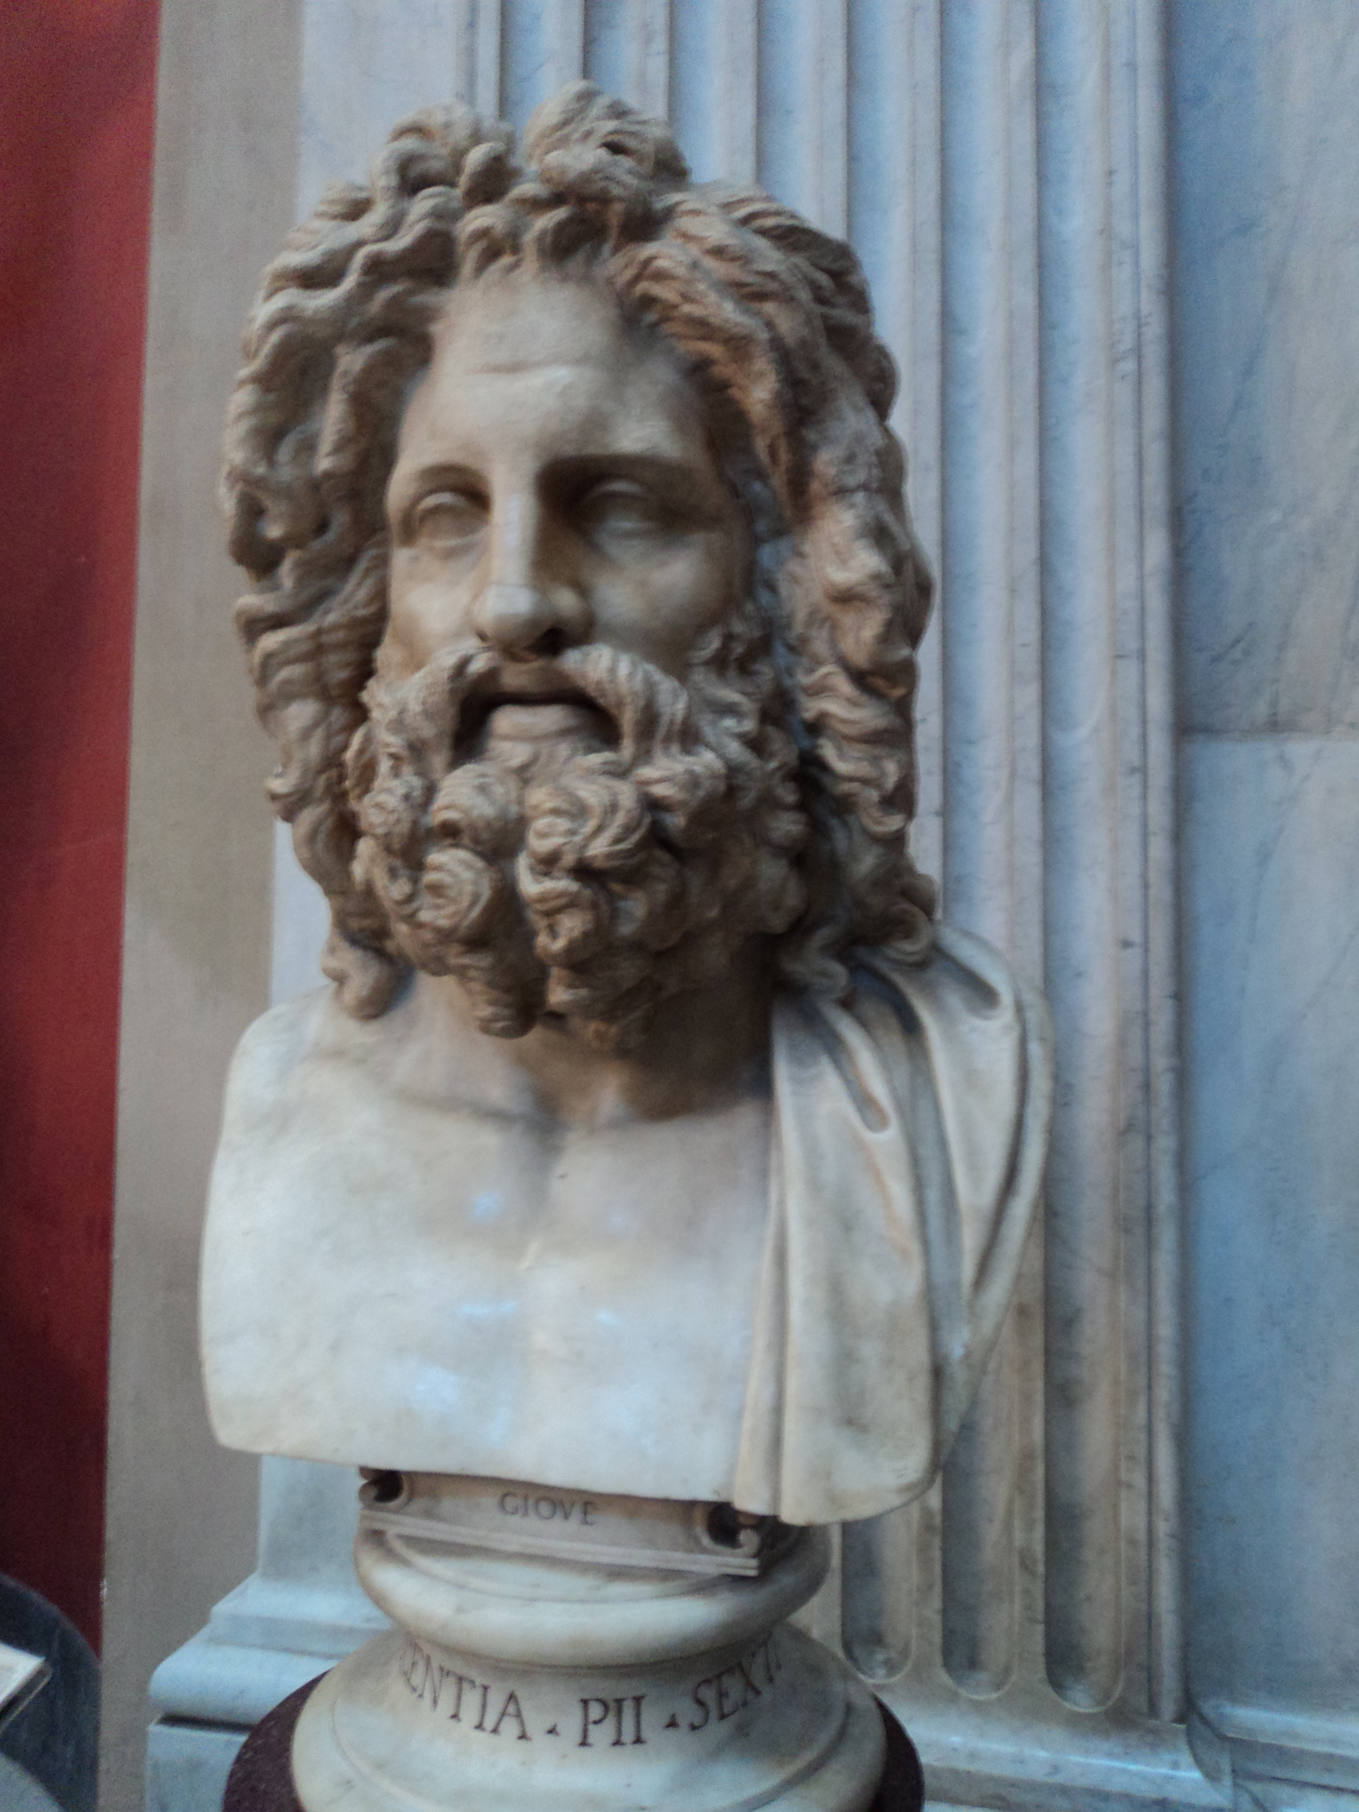
I. Properties
A. Basic Info
1. Most powerful Roman god
2. 4th brightest object in the sky
3. 4 large moons, many smaller
B. Size (*compare mass to other planets)
1. 318 M_{E} / .001 M_{S} / 11.2 d_{E}
2. Density only 1300 kg/m³

Slide 4
C. Rotation
Differential
rotation
2. Fastest avg. rotation: ~ 10 hrs.
3. Big equatorial bulge
a. Due to fast spin
b. It’s mostly liquid/gas, not solid

Slide 5
II. Atmosphere
A. Great Red Spot
1. Hurricane 2-3x
size of Earth
2. At least 300
yrs. old (1665)
3. ~ 250 mph
winds
4. Engulfs smaller
storms

Slide 6
The Great Red Spot

Slide 8
Red Spot Jr.

Slide 9
B. Composition
1. 84 % H₂ / 14 % He
2. Gravity kept light elements
C. Atmospheric Bands
1. Bright zones (upward convection)
2. Dark belts (downward convection)
3. Hi/lo pressure systems wrapped
around planet due to fast rotation

Slide 10
4. Alternating East/West flow
5. White & brown ovals
6. Different depths seen
7. Lightning
8. Colors poorly understood

Slide 12
III. Internal Structure
A. Jupiter emits 2 x energy it receives
B. Not massive enough to be a star
C. Orig. energy (heat) of its formation
D. Interior
1. Clouds ~ 125 miles thick
2. Under-- H₂ becomes liquid (press.)
3. Metallic liquid (~12,000 mi. deep)
4. “Rocky” core - 10 M_{E}

Slide 13
Interior of Jupiter

Slide 14
IV. Magnetosphere
A. Huge sea of charged particles
1. 20,000 x stronger field than E’s
2. Radio from accelerated particles
3.Teardrop shape due to solar wind
4. Stretches to Saturn
B. Strength - liquid core / fast rotation
C. Huge aurorae
E.

Slide 16
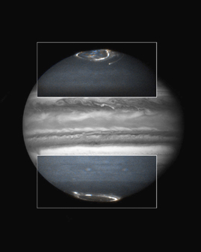
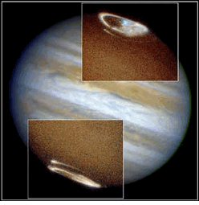
Aurorae on Jupiter

Slide 17
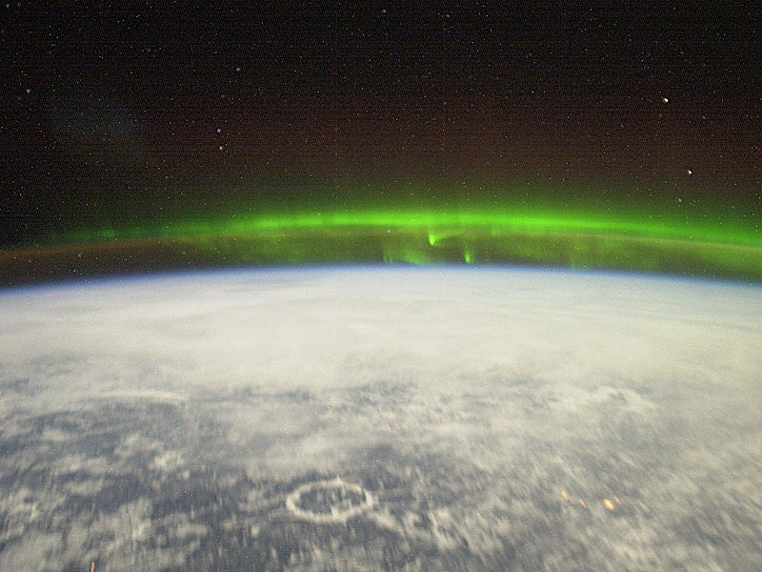
Earth’s Aurorae from Space
View from the ISS..
.. and as seen in ultraviolet..

Slide 19
Sec 6.2 Moons of Jupiter
Basic info
1. Some moons formed w/Jup., others –
captured asteroids.
Dozens of little moons -
- 4 closer than Io
2. At least 63 total!
3. Some have retrograde orbits
4. Most discovered since 2000

Slide 20
Rare Triple Transit Oct. 2013

Slide 21
Galilean Moons

Slide 22
B. Galilean “Solar System”
1. Direct, nearly circular, flat orbits
2. Gravitationally (tidally) locked
3. Density decreases away from planet
a. Io/Europa: Large iron cores
b. Ganymede/Callisto: More ice
4. Orbits are in resonance (1:2:4)

Slide 24
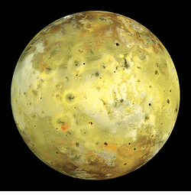
C. Io - The Most Active Moon

Slide 25
1. Similar mass/radius to our Moon
2. **Most geologically active object**
a. Very hot, powerful volcanoes
b. Voyager I found 8 erupting at once!
c. Sulfur compounds create colors
d. No craters, cracks, etc.. (youngest)
e. Thin, temporary atmosphere of SO₂
f. Maps
change
constantly

Slide 27
Plume 2007

Slide 29
3. Plasma torus (mmm.. space doughnut)
a. Magnetosphere covers inner moons
b. Sweeps up particles from Io’s volcanoes (lots of sulfur in plasma)
c. Strong, dangerous radiation
d. Can be photographed from Earth
4. Tidal stress: Io’s interior stretched & squeezed Ex/ bending a wire

Slide 30
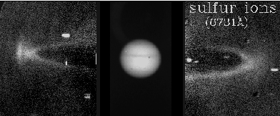
Io’s
Plasma
Torus

Slide 32
D. Europa: Liquid Water

Slide 34
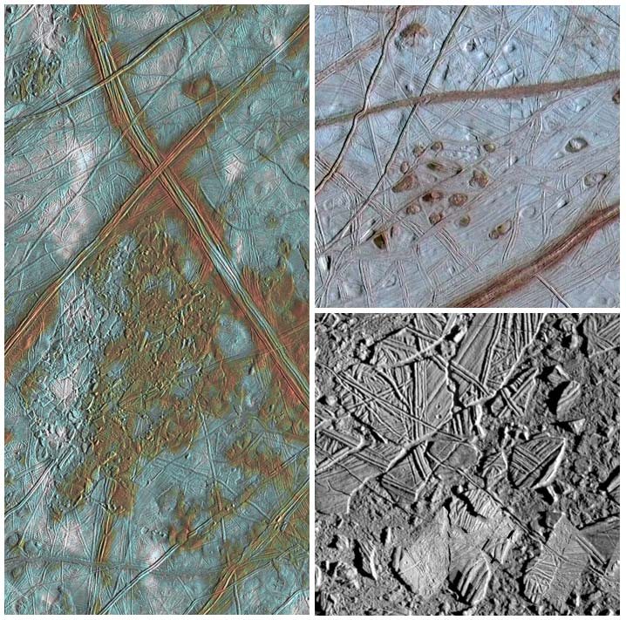
1. Few craters -- young surface
2. Cracks/lines due to tidal forces
3. 60 mile deep ocean under ice??
a. Could have more water than Earth!
b. Icebergs may form,
move, refreeze
4. Weak, var. mag. field –
salt water?
5. Life?? 6. JUICE

Slide 36
Lake on Europa - 2011

Slide 37
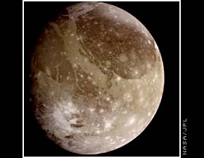
E. Ganymede & Callisto

Slide 38
1. Both low density (2000 kg/m³)
2. Lots of ice
3. Ganymede -- *largest moon
a. Dark, old areas - ex/ Galileo Regio
b. Light areas - release of water
c. Meteor impacts (ice “*maria”)

Slide 39
d. Grooves - past *tectonic motion
e. Weak, variable magnetic field
(moving slush?)
f. Magnetosphere
(only moon)

Slide 40
Inside Ganymede

Slide 41
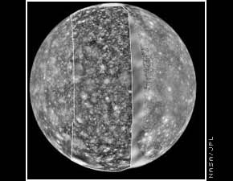
4. Callisto - most heavily cratered object
a. 2 large basins w/ concentric ridges
b. Largest basin - Valhalla
c. No internal differentiation d. No
internal
heat

Slide 42
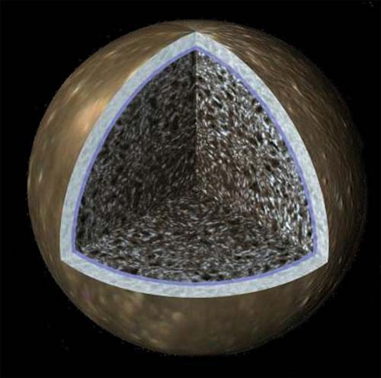
Inside Callisto
Valhalla

Slide 43
VI. Jupiter’s Ring
A. Discovered by Voyager (1979)
B. Above clouds / inside moons
C. Very thin in every direction
D. Small, dark fragments of ring may have come from 2 nearby moons

