Slide 1
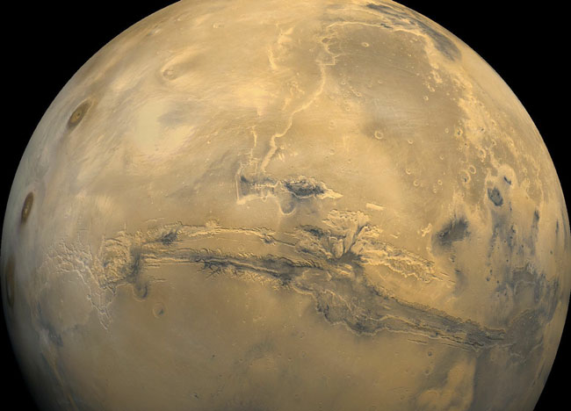
Ch. 5 MARS

Slide 2
Named after the Roman god of ____. Is there liquid water? Life???
Orbital Properties (Sec 5.5)
A. Outermost terrestrial planet
B. Large eccentricity (.093)
1. 2nd most elongated (1.38 - 1.67 AU)
2. Sunlight 45% more intense at perihelion
C. Mars can be seen far from Sun
1. Best seen at opposition (~every 2 yrs.)
2. Closest approach - .37 AU

Slide 5
D. Mars is dim
1. Twice as far from Sun as Venus
- light 1/4th as intense
2. Only 30% of Venus’ surface area
3. Only 15% reflective
4. Can be brighter than any star
5. Reddish-brown tint (iron oxide)

Slide 6
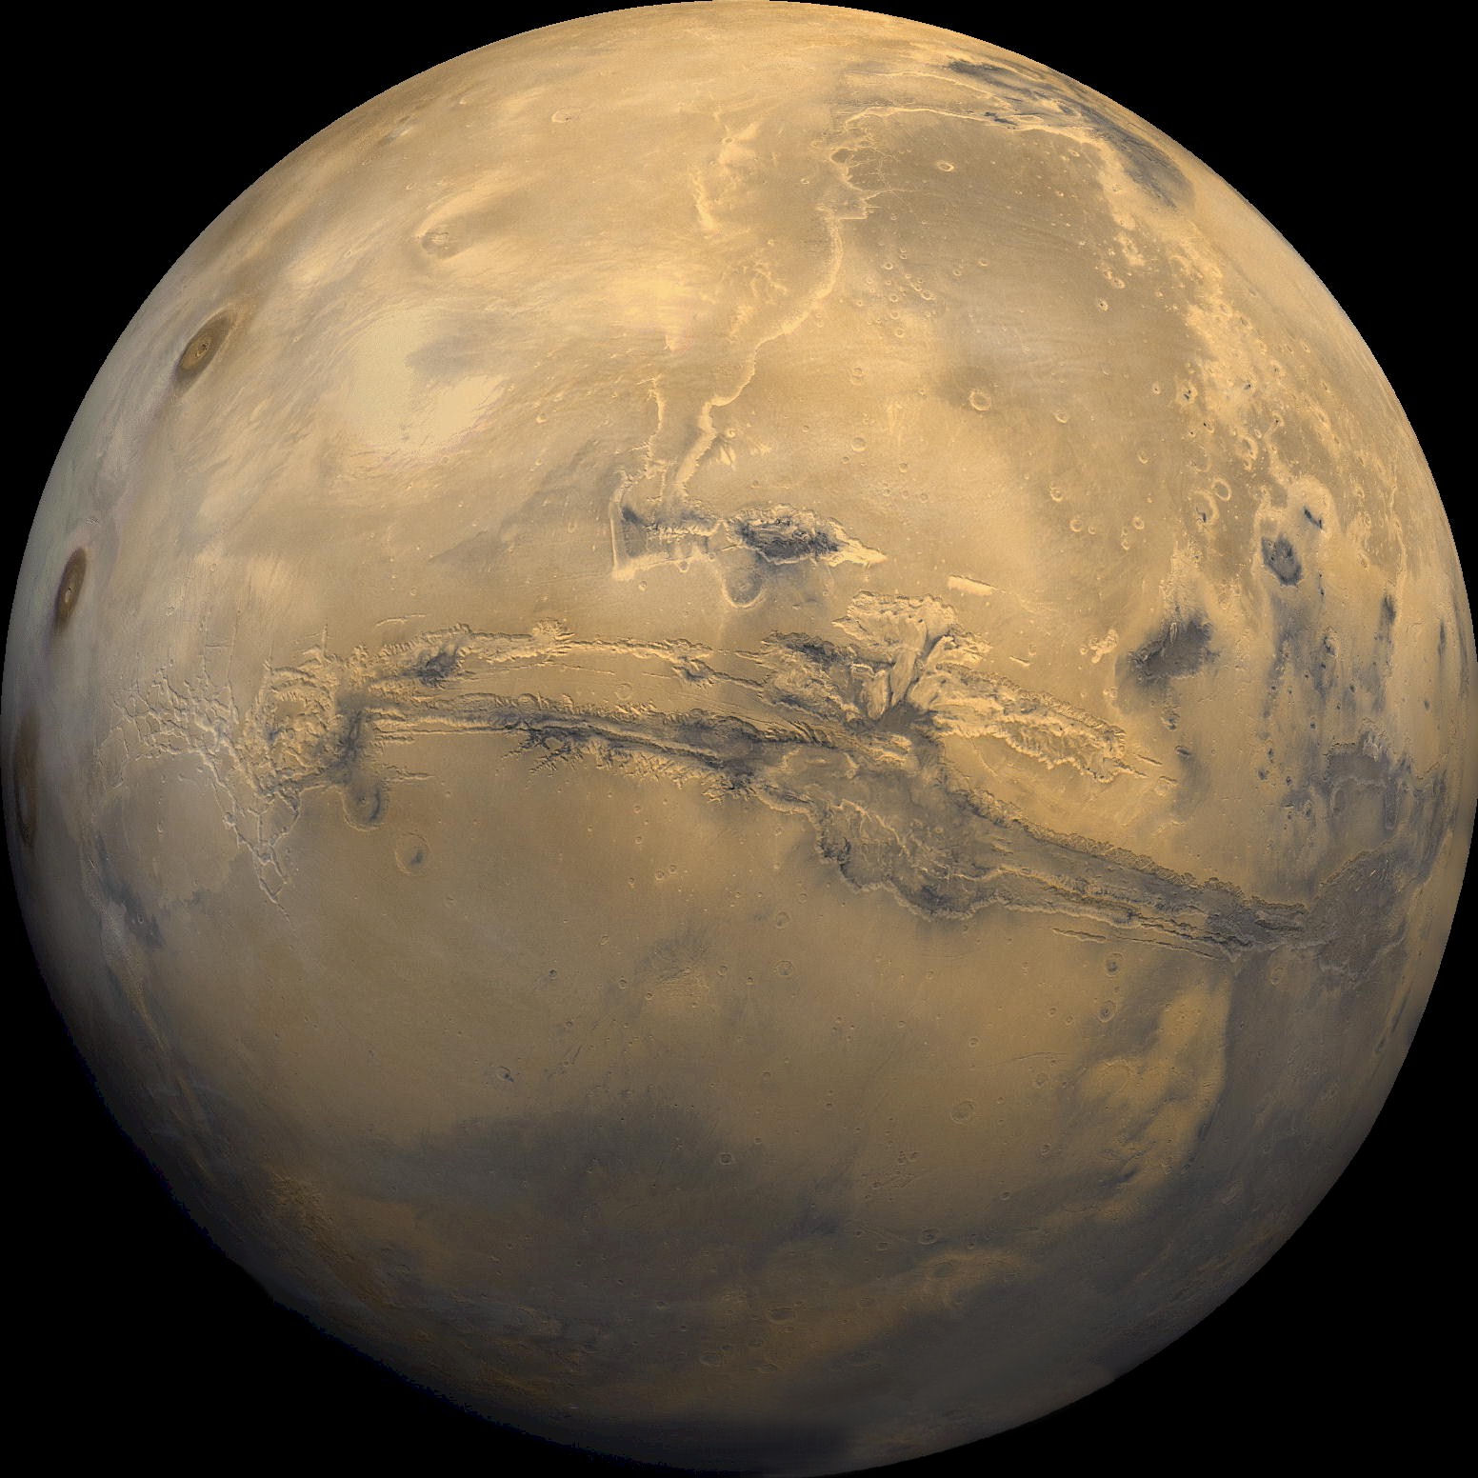

Slide 7
II. Physical Properties (Sec 5.6)
A. Size: .53 d_{E} / .11 M_{E}
B. Density: 3900 kg/m³
(Core of iron sulfide)
C. 2 small moons: Phobos/Deimos
(sons of Ares & Aphrodite)
D. Earth-like properties
1. 24.6 hr rotation / 24º tilt
2. Eccent. - greater seasonal diff.

Slide 8
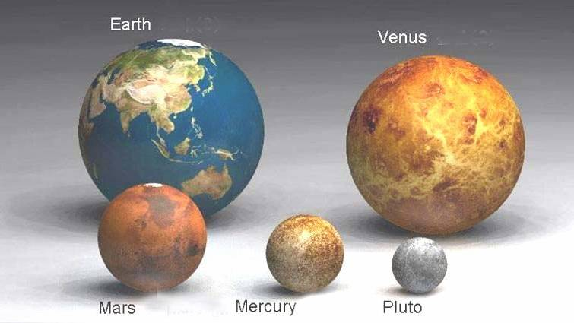

Slide 9
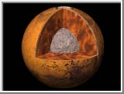
InSight 2016!!
E. No seismic studies (Viking failed)
F. No global magnetic field - core
non-metallic or solid or both
G.Never melted as much as V or E
1. Heat escapes smaller planet
2. Volcanism has ceased
3. No plate tectonics

Slide 10
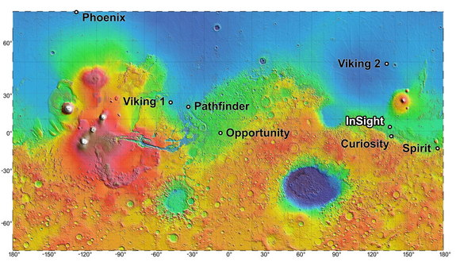
InSight Mission (2016)
http://www.space.com/17208-what-s-inside-mars-nasa-s-insight-mission-will-probe-deep-video.html

Slide 11
H. Features not easily seen at opposition –
I. Bright polar caps
1. Grow / diminish seasonally
2. Mostly frozen CO₂ and H₂O
J. Dark features change - dust
storms / winds (Mariner 9)

Slide 13
Dust devils on Mars!

Slide 14
III. Surface of Mars (Sec 5.7)
A. Large scale topography
1.Maps- Viking & Global Surveyor
2. Hemispheres
a. North - lava plains (~ maria)
i. Larger lava plains than M or E
ii. Fewer craters - younger surf.
iii. Lower elevation

Slide 15
b. South
i. Heavily-cratered highlands
ii. Older, original crust (4 bill. yrs)
iii. Sits 5 km (~ 3 miles) above N.
3. Tharsis bulge - only “continent”
a. Rises ~ 6 miles above equator
b. Size of N. America
c. Youngest region (2-3 billion yrs.)

Slide 16
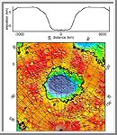
4. Hellas Basin
a. Lowest pt. on Mars
b. Opposite side of
Tharsis bulge
c. Floor ~ 5.6 miles below rim
d. Impact feature

Slide 18
B. Largest volcanoes in solar syst.
1. 4 largest on Tharsis bulge
a. OLYMPUS MONS
i. >400 mile wide base (Texas)
ii. Rises >15 miles above plain!
iii. 2.5 x taller than Mt. Everest
iv. Mauna Kea - 75 miles / 5.6 mi
v. Its caldera - 50 miles wide!

Slide 19
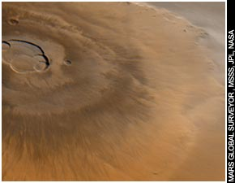
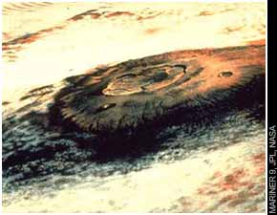
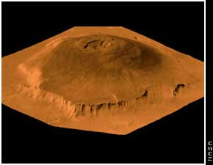

Slide 22
b. Other 3: only 11 miles high!
2. All shield volcanoes (no plate t.)
3. Avg. 2.5 x higher than E or V -
lower gravity (38 % g_{E})
4. No recent eruptions
C. Impact Cratering
1. Dust erodes craters faster than Moon
2. Ejecta indicates permafrost
3. Surveyor: Gullies indicate water

Slide 23
“Splosh”

Slide 24
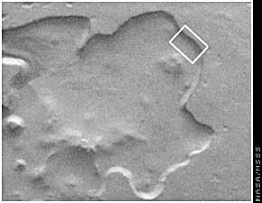
Evidence of Water (?)

Slide 25
Recent Water (!) on Mars (‘06) (see next page for before/after)

Slide 27
D. VALLES MARINERIS:
The Martian “Grand Canyon”
1. Formed by tectonic fractures that created the Tharsis bulge
a. Not the same as plate tectonics
b. Not formed by flowing water
2. Stats: 2500 miles long; 75 miles across (max); over 4 miles deep
(Grand C.: 277 long; 12 wide; 1.2 deep)

Slide 29
E. Evidence of Water
1. Extensive runoff channels
a. Southern highlands
b. Ancient, dried-up river beds
c. Atmosphere thicker; warmer
2. Outflow channels
a. Remnants of catastr. flooding
b. Equatorial region

Slide 30
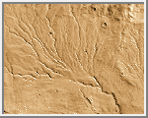
Rivers of Mars

Slide 31
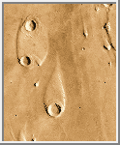
c. More water/sec than Amazon
d. Flash floods from South to North
e. Teardrop-shaped “islands”
where flood hit craters, etc..
3. Past rivers, lakes, oceans?
4. Water now -permafrost & ice caps
a. 4 bill. yrs. -water froze; rivers dried
b. 3 bill. yrs. -volcanoes melted ice?
c. Volcanoes stopped; water refroze

Slide 32
Ancient Ocean ?

Slide 34
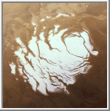
F. Polar Caps
1. Mostly CO₂ frost
2. Seasonal cap
a. Grows / shrinks thru year
b. Larger at the South pole
c. Thin: ~ 1 m max. thickness
d. Greatly affects atmosphere
(30% pressure change)

Slide 35
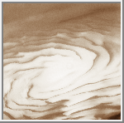
North cap

Slide 36
3. Residual cap
a. Permanently frozen
b. Smaller/brighter than seasonal
c. North - larger, mostly water ice
d. South - smaller residual cap
(larger seasonal, CO₂ cap, though)

Slide 37
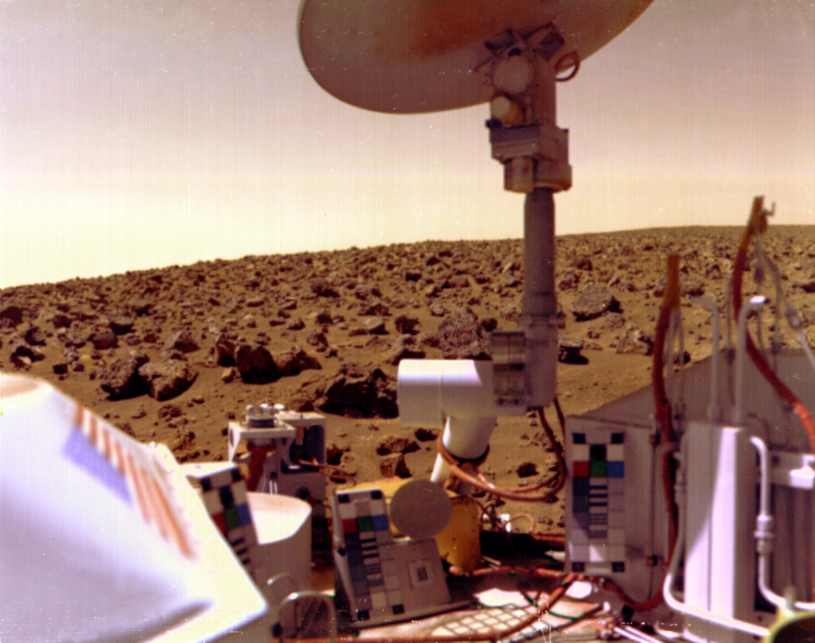
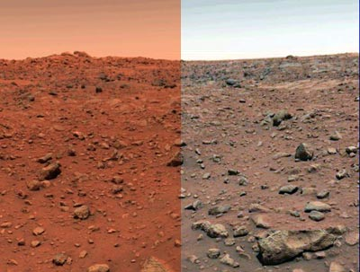
G. The Martian Landers
1. Viking I & II (1976)
2. Viking II landed farther
north in much rockier terrain
3. Soil rich in iron- iron oxide (rust)

Slide 38
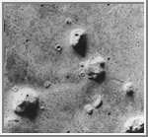
The Face on Mars: 1970’s

Slide 39
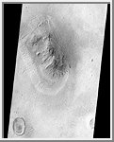
The Face on Mars: I990’s

Slide 40
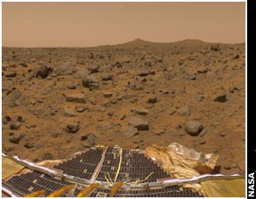
Mars 1997 (Pathfinder)

Slide 41
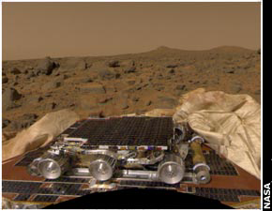
4. Mars Pathfinder (1997)
a. Robot rover: Sojourner
b. Near mouth of outflow channel
c. “Faster, Better, Cheaper”

Slide 44
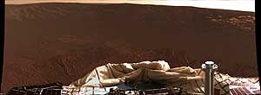
Spirit & Opportunity ‘04
Hole in One!

Slide 45
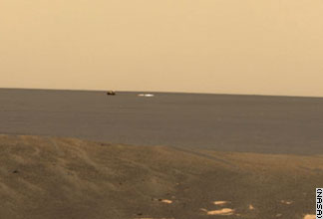
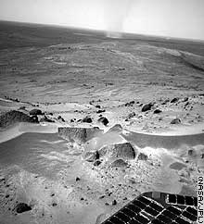

Slide 46
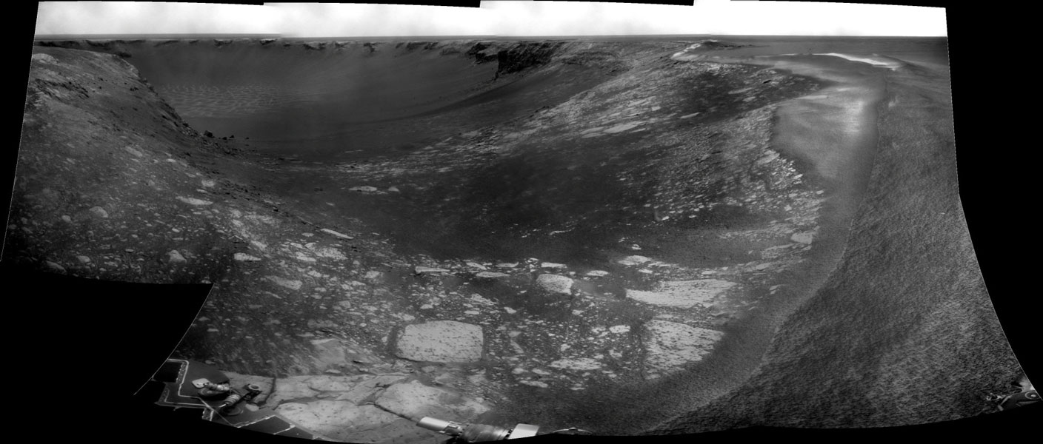
Victoria Crater

Slide 48
MRO ‘06

Slide 50
Play original through Quicktime

Slide 54
MARS Phoenix Lander - May ‘08

Slide 58
CURIOSITY (2012)

Slide 59
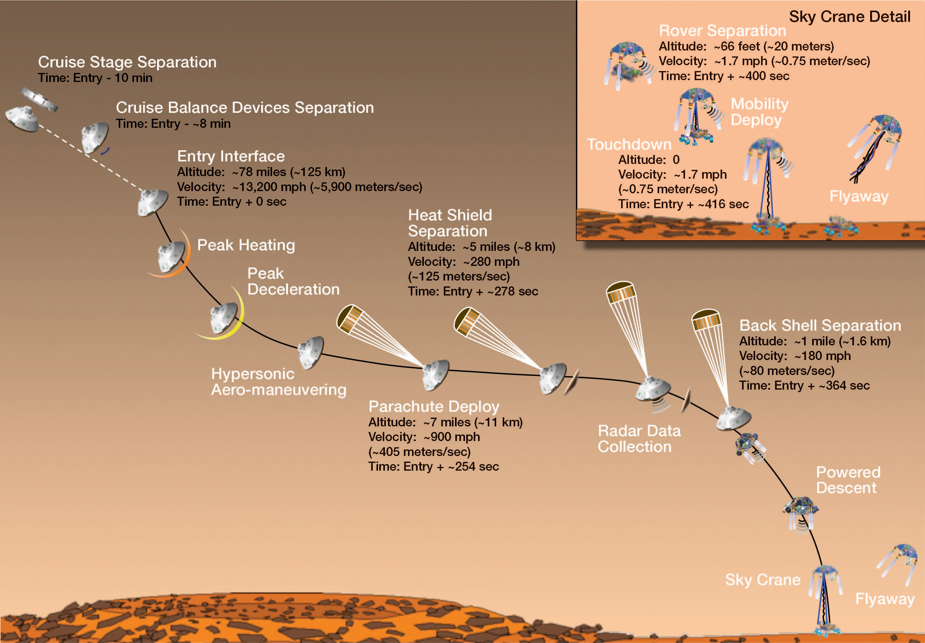
EDL – Entry, Descent, & Landing
http://www.space.com/16265-7-minutes-of-terror-curiosity-rover-s-risky-mars-landing-video.html

Slide 62
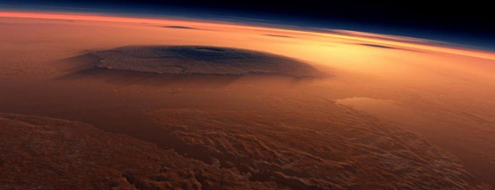
IV. Martian Atmosphere
A. Composition 1. Thin atmosphere
a. 1/50th E’s pressure- sea level
b. 95% CO₂ c. Trace amounts of H₂O
d. 2008 Phoenix – Snow!

Slide 64
2. Surface temps
a. Avg. temp 122º F cooler than E
b. Temps may drop 200º at night
c. High: 81º F (noon, summer..)
d. Low temps produce canyon fog
3. Seasonal changes: Planet-wide dust storms during Southern summer months

Slide 67
B. Evolution of Atmosphere
1. Thick atm. 4 billion yrs. ago (comfortable temps, blue sky, rain)
2. Disappeared over next bill. yrs
a. CO₂ dissolved into lakes/rocks
b. Greenhouse diminished- cooler
c. Water froze out of atm. - cooler
d. Enough ice now to flood planet

Slide 69
V. Moons of Mars (Sec 5.9)
A. 2 small moons- Phobos/Deimos
B. Discov. in 1877 by Asaph Hall
C. Close, tidally-locked, nearly circular orbits
around the equator
D. Captured asteroids
1.Irregular shape/heavily cratered
2. Phobos larger; has crater Stickney
3. Very dark (6% reflective)
4. Low density (2000 kg/m³)

Slide 70
Phobos

Slide 71
Phobos ‘06

Slide 74
Martian meteorite

