Slide 1
Life in the Universe?

Slide 3
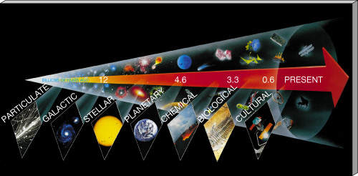
I. Cosmic Calendar:
The 7 stages in the history of the cosmos are particulate, galactic, stellar, planetary, chemical, biological, & cultural.

Slide 4
The cosmological calendar
Jan. 1st – the Big Bang (13.8 bya)
Jan. 15th – First Stars Form
Jan. – Mar. Galaxies Form
Mar. 15th – the Milky Way (11 bya)
Sept. 1st – The Sun formed (4.6 bya)
Sept. 16th – Oldest Rocks on Earth (4.0 bya)
Sept. 21st – First Life (3.8 bya?)

Slide 5
The cosmological calendar
Oct. 12th – Photosynthesis (3 bya)
Nov. 9th – Complex Cells (2 bya)
Dec. 5th – Multicellular Life (1 bya)
Dec. 14th-23rd – First arthropods, fish,
Dec. 26-28th – Mammals, birds, flowers
Land plants, insects, Amphibians, Reptiles
Dec. 30th – Extinction event – dinos die out
Dec. 30th – First primates

Slide 6
The cosmological calendar – Dec. 31st

Slide 7
The cosmological calendar – Last minute

Slide 9
II. The Drake Equation
A. Has no answer – just an estimate
1. Divides a large question into a
series of smaller ones
2. Estimates the number (N) of
advanced civilizations in the
Milky Way today
B. The terms of the equation

Slide 10
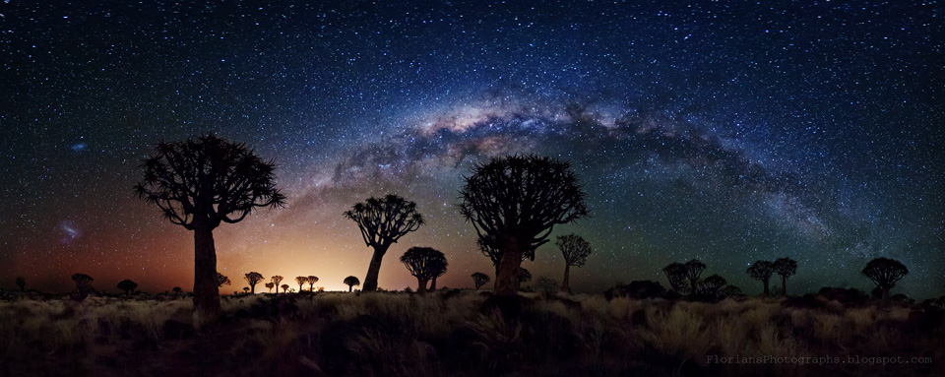
1. R* - # of stars in our galaxy

Slide 11
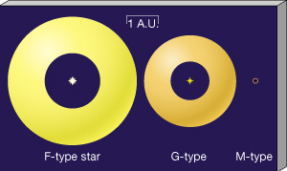
2. f_{S} - Fraction of sun-like stars

Slide 12
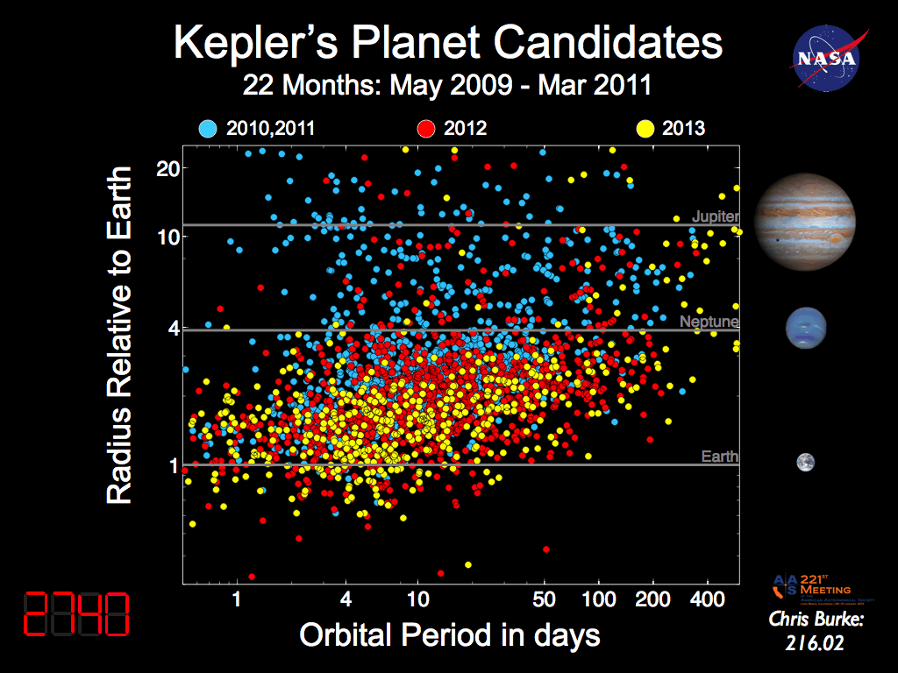
3. f_{p} -Fraction of stars w/ planets
a. At least 1 planet per star seems likely
b. Our guess is getting better each day!

Slide 13
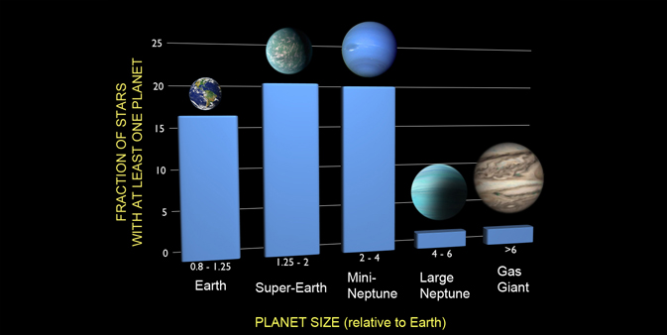
4. f_{E} – Fraction of Earth-like Planets per Solar System
a. Temperature is the key
i. Proximity to star
ii. Thickness of atmosphere
iii. Habitable
zone
b. 1 per 6 ?

Slide 15
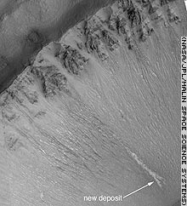
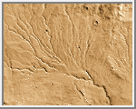
c. What is meant by “earth-like”?
i. Mars had a warm, wet past –
could there be fossilzed life in
meteorites? What about
underground microbes today?

Slide 16
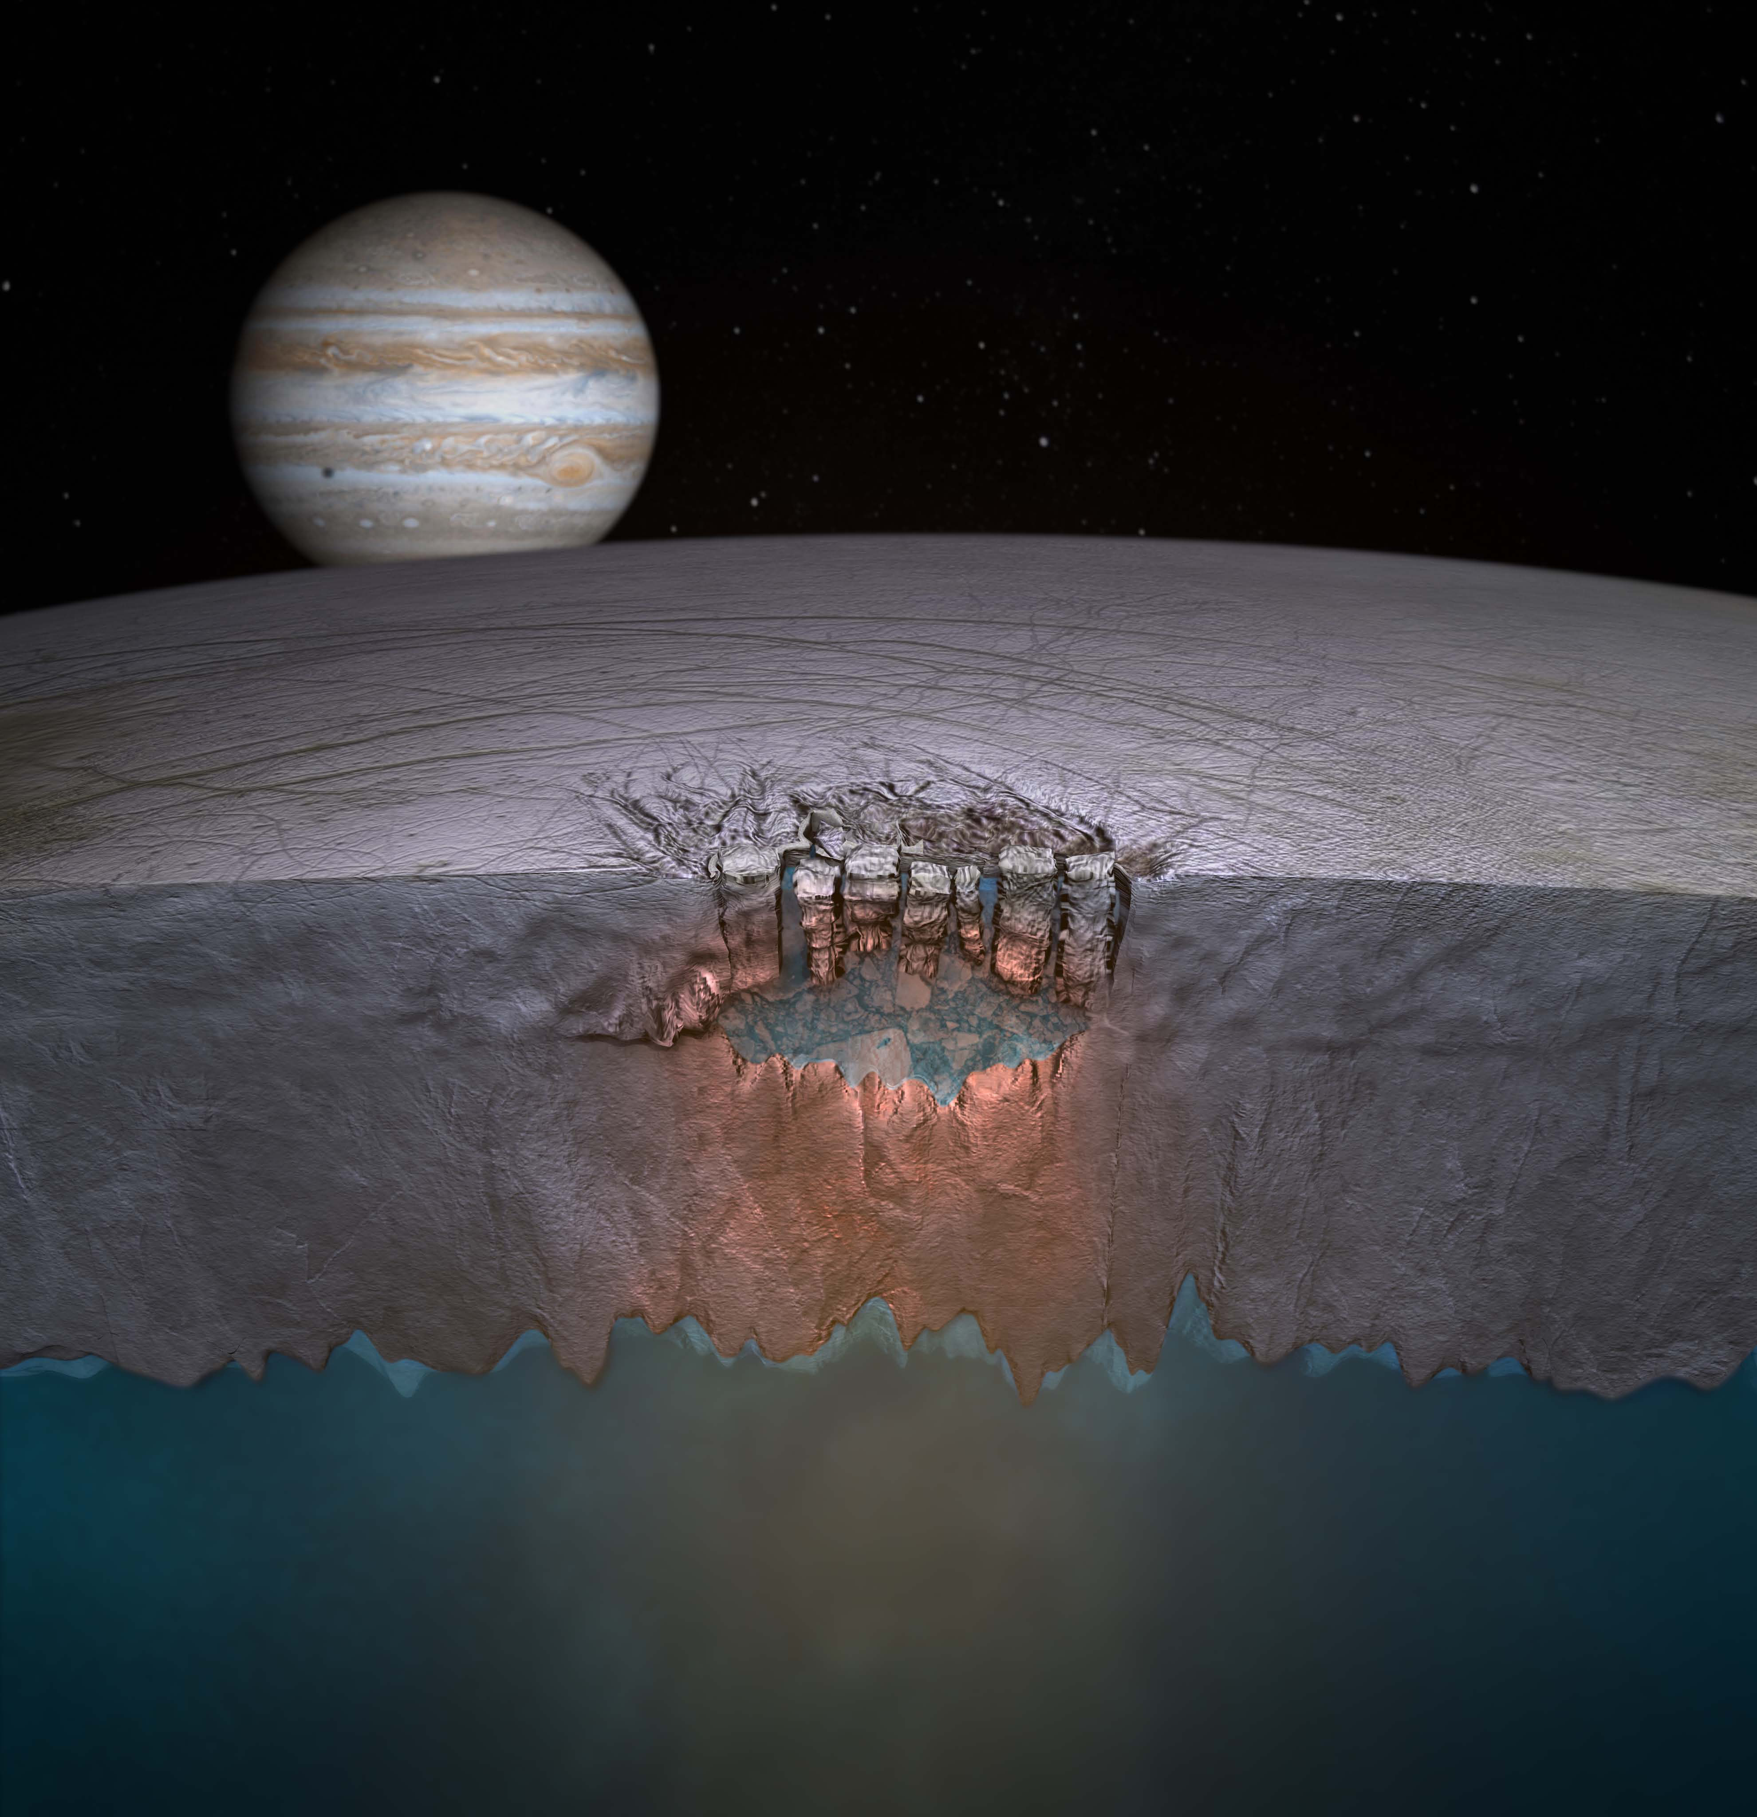
ii. Europa – ocean vents?

Slide 17
iii. Enceladus - water geysers

Slide 18
iv. Titan - carbon, but colD(!)

Slide 19
v. Ganymede 2014 - layers of ice and water?

Slide 20
5. f_{L} - Fraction of habitable planets which have LIFE
Low value: life is rare or nonexistent in the galaxy
Value of 1: Life is inevitable given enough time
We need more examples! (Europa, Mars, etc..)

Slide 21
d. What is meant by “life”? There is
no set definition Ex/ Virus
e. Typical attributes of life
i. React to their environment
(heal themselves, etc..)
ii. Can grow
iii. Can reproduce
iv. Can evolve over generationss

Slide 22
f. A Chemical Evolution for Life?
i.Urey-Miller Experiment (1953) -
exposed simple elements to early Earth-like environment
(Radiation, “lightning”, etc..)
ii. Amino acids & complex organics formed! Building blocks of life..

Slide 24
g. An interstellar origin for life?
i. Organics can form in
molecular clouds
ii. Comets contain organics
iii. Meteorites have been found
with organics
Ex/ Murchison Meteorite found
w/ 22 amino acids

Slide 25
h. Alternative biochemistry?
i. Carbon is chemically
flexible, but so is silicon
ii. Water has a wide temp. range as a liquid, but ammonia might be used as a medium on a cold planet

Slide 26
6. f_{I} - Fraction of Worlds that Develop Intelligent Life
Natural selection would seem to favor intelligence
However, intelligence took billions of yrs. to develop
We could be the most intelligent life in the galaxy!
(Yikes!)

Slide 27
d. Biological evolution was an
incredibly slow process early on
i. 3.5 billion yrs. ago:
Single-celled blue-green algae
ii. 2 billion yrs. ago: Amoeba
iii. 1 billion yrs. ago: Sponges

Slide 28
e. Biological ‘big bang’(570 million years ago)
i. Number of species exploded
ii. Advantageous traits such as
intelligence evolved

Slide 29
Dolphin Intelligence in Action

Slide 30
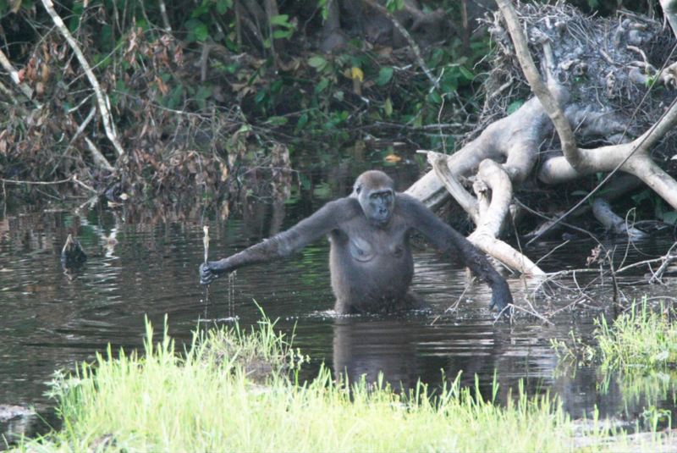
7. f_{T} - Fraction w/ technology
i. Every isolated ancient
civilization developed tech.
ii. Other life on Earth has
“tech”, but not radio dishes
iii. Probably
inevitable

Slide 31
Tool Usage in Chimps

Slide 32
2001: A Space odyssey

Slide 34
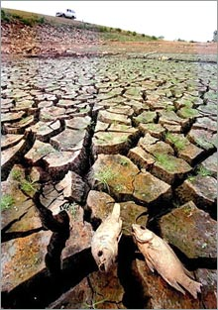
8. L – Lifetime of technologically- advanced civilizations

Slide 35
i. Radio was developed in the late 1800’s
ii. Nuclear power had been harnessed by
the 1940’s (Manhatten Project)
iii. Cold War - Cuban Missile Crisis (1962)

Slide 36
III. The Search for Extraterrestrial Intelligence
The Drawbacks
1. Even if there were 1 million
civilizations, they would be 100
light years apart on average!
2. Stars too far away for travel
a. 50,000 y to Alpha Centauri
b. 600,000 yrs. to go 100 l.y.

Slide 37
B. The fermi paradox
“The apparent size and age of the universe suggest that many technologically advanced extraterrestrial civilizations ought to exist. However, this hypothesis seems inconsistent with the lack of observational evidence to support it.”

Slide 38
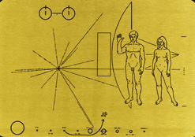
C. Do we want E.T. to find us?
1. We’re a young, primitive technological civilization
2. Just in case,
we sent a
plaque on
Pioneer 10

Slide 39
D. Radio broadcasts
Cheaper, more practical
Earth’s radio has reached over 1,000 stars (~65 l.y.)
The “Water Hole” (H & OH)
4. SETI (Project Phoenix ‘90s)
a. Home-based SETI
b. Allen Telescope Array (ATA)
- 350 radio dishes!

Slide 40
Contact 1997

Slide 41
Timeline of scientific discovery

